Slide 1

X-Lint
December 8, 2011
Lowell-Bellew | Boonyasastian | Goldstein | Meadowcroft
Notes:
JLB here w/ Tee, Brennan & Jon to introduce an award-winning, patent-pending technology: the X-Lint.

Slide 2
Save you time
Award winning, patent pending
X-Lint helps…
Save you money
Save the environment
Save your life*
Notes:
Clogged dryer filters increase drying times, waste energy, and pose fire hazards. || The X-Lint SAVE… [BUILD]
Utilities rebate CFLs & EE devices like the X-Lint. For them, X-Lint=1.8 B kWh at 10% market penetration: more than 1.2 M tons of CO2 emissions avoided, annually.

Slide 3



=
Notes:
X-Lint ~ CFL for your dryer. It’s easy & saves Time & $ ; in less time than it takes to screw in a light bulb, you can install your X-Lint – just pull out your dryer filter and insert the X-Lint replacement – no tools – easy… So who is it for…?

Slide 4
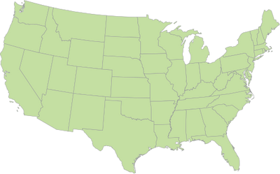
Notes:
~100M dryers in the US, alone. Brennan will outline segments in a moment: Homeowners, Laundromats & Institutions

Slide 5

Clothes dryers hog 5.8% of US residential electricity, annually
$7,051,300,000
Notes:
Pulling back to look at the big picture helps put the need in perspective. Clothes dryers are energy hogs. They account for 5.8%-12% of home electricity use. →[CLICK] At current rates, Americans spend ~$7B each year just drying our clothes!

Slide 6
As the efficiency of the dryer increases, so do the annual savings…
30% → $40
20% → $26
10% → $13
Notes:
Majority of 93M : 6-9/week || Our #s conservative: 7 loads/week, 5.8% (not 12%), avg per kWh$0.107.
Certain market segments like CA & NY have 20%+ higher energy costs.
more about saving environment later, but not expecting people to buy X-Lint for environmental reasons.
We expect the energy and time savings as well as safety to be the primary drivers.

Slide 7
For some, the gains could be even higher…
Additional Gains
$13 - $40
User cleans less than every cycle
Baseline
Average User
Notes:
We presume that users are cleaning their filters between cycles: Start at a baseline for the average user… [CLICK]
Average users can expect this benefit [CLICK – CLICK]
10% of survey respondents do not clean filter between cycles, but less frequently.

Slide 8
…How?!
Notes:
So, “HOW?”, right?! What is this innovative breakthrough, this award-winning, patent-pending technology that’s so easy to use yet promises to save time, money, the environment, and possibly your life?
Well, I leave it to Brennan to reveal the innovative answer…

Slide 9
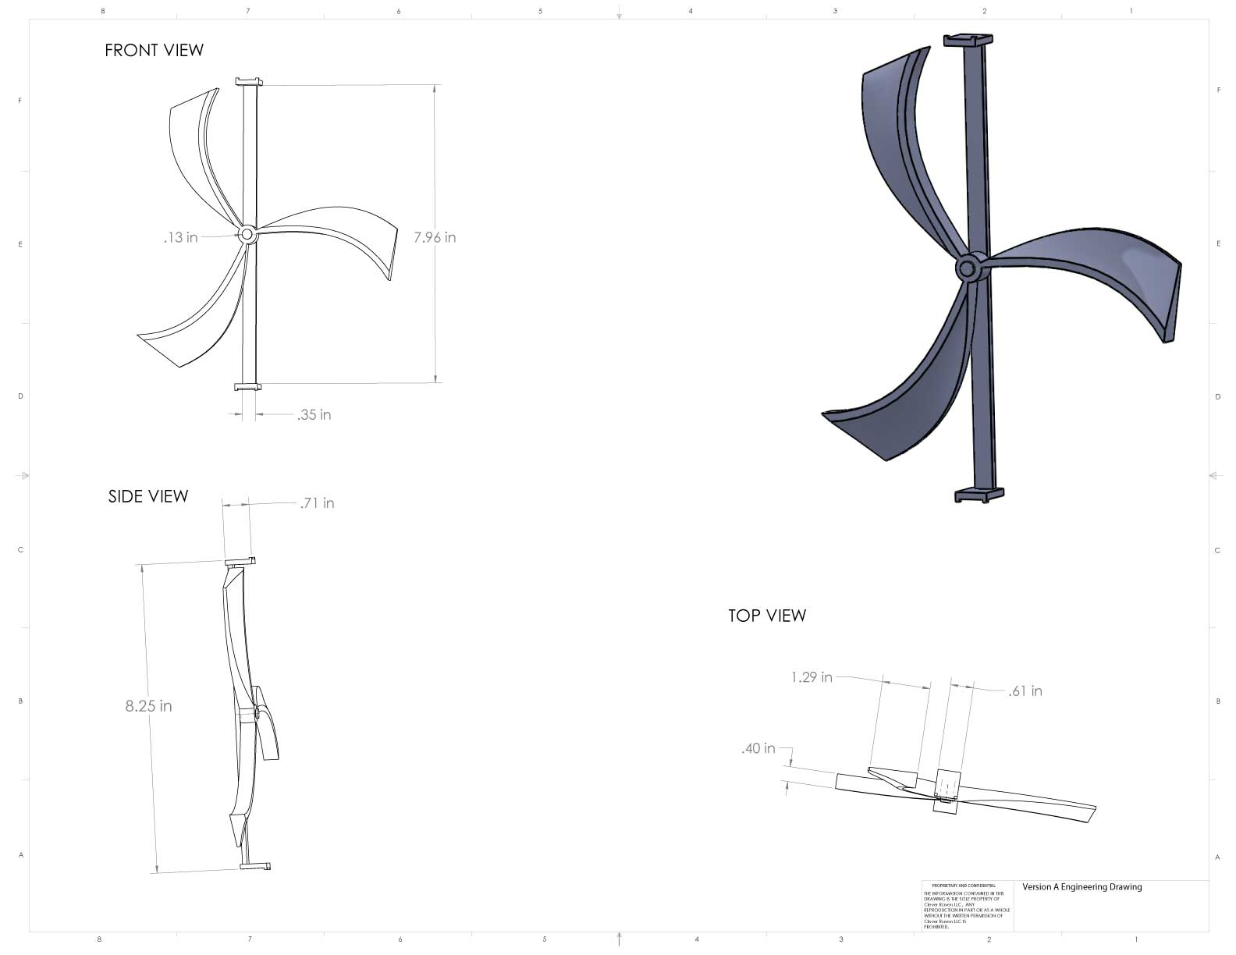
Improve the airflow…
Notes:
The design of a standard clothes dryer has essentially remained the same for years and years
IT’S TIME FOR A CHANGE.
It’s not rocket science that pushing air through a clogged filter is harder than pushing it through a clean one.
It turns out, clogged dryer filters reduce airflow and increase drying times. [CLICK]
(prototype passed to judges)
As you can see, the X-Lint attaches to a dryer filter. Airflow spins the propeller which, in turn, brushes against the filter, throughout the dryer cycle and removes lint from its path. In later prototype versions, there is a ring around the propeller to collect this lint.
By preventing lint buildup, X-Lint provides a path of least resistance for the air and reduces drying times.
As an added benefit, this award-winning patent pending technology could save your life by reducing the possibility of dryer fires which occur 15,000 times each year in the US due to equipment overheating and igniting built-up lint while as a result of straining to push air through clogged filters – the best $45 insurance policy you ever bought.

Slide 10
  Easy to install
  Clears lint throughout cycle
X-Lint
  10% - 30%
  Efficiency Gains
  Price: $45.00
Notes:
X-Lint is an award-winning, patent-pending technology that…
Is really easy to install. One of the greatest features of the X-Lint is how easy it is to get it up and running. You simply pull out your old dryer filter and slide in the X-Lint… boom! Done! Simple. [CLICK]
Clears lint throughout the cycle. This is the magic of the X-Lint. It actually uses the airflow normally generated by the dryer to drive the fan. As the fan spins, it pushes the lint to the outside of the area swept by the blades, leaving an open space for air to easily pass through. As long as your dryer is running, so is the X-Lint. It is elegant and simple; you don’t have to worry about settings or whether the battery still has a charge – it’s a passive device, powered by the airflow in the dryer: brilliant! [CLICK]
Offers 10-30% efficiency gains. By opening a clear path for the air to escape out of the dryer, it becomes more efficient… 10% - 30% more. As we saw earlier, this means an average of $40 in annual savings.
All of these incredible benefits at a price of $45. We’ll show you where that stands relative to other options in a little bit.
That’s incredible benefit that doesn’t account for any time savings, green benefits (environment) or safety value (life/fire)

Slide 11
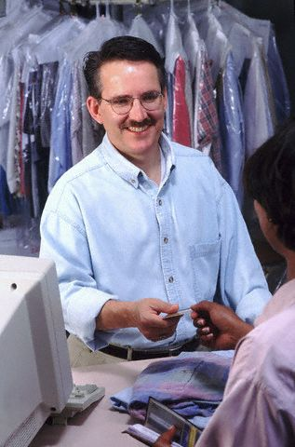


Some people are interested in cutting energy costs…
Notes:
There are several different segments of the market that would be interested in cutting down their electricity costs… Let me introduce them to you.

Slide 12
Larry – The Laundromat Owner
35,000 locations
Urban areas – high renter population
20 Dryers
Notes:
Larry the Laundromat Owner… he owns and operates one of the 35,000 Laundromats nationwide. His shop is located in an urban area with a high renter population. On average, he operates 20 dryers in his business.
http://coinlaundry.org/resources/industryoverview.cfm

Slide 13
Paul – The Purchasing Agent
2,200 locations in US with on-campus housing
Residence halls average between 300-400 students
24,638 locations in US with 2+ units
Multiple Units
Multiple Locations
Universities & Apartment Complexes
Notes:
http://www.peterli.com/cpm/pdfs/2011-College-Housing-Report.pdf
http://www.nmhc.org/Content/ServeContent.cfm?ContentItemID=1152
Paul the purchasing agent is in charge of buying decisions for multiple locations that have multiple units such as Universities and Apartment complexes.

Slide 14
George & Martha - Homeowners
93 Million US Households
6-9 uses/week average
$115.45 annual cost
Notes:
And finally, George and Martha… homeowners. There are 93 million homeowners just like George and Martha. They use their dryer 6-9 times per week and spend an insane $115 per year on electricity just to dry their clothes.

Slide 15


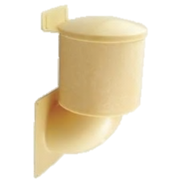
HIGH COST
LOW
ENERGY
SAVINGS
HIGH
ENERGY
SAVINGS
Status Quo
LOW COST
Notes:
Energy savings vs. payback period?? BANG FOR YOUR BUCK in terms of savings compared to cost of product
Who are the other businesses that are trying to get the attention of Larry, Paul and George and Martha? As it turns out, X-Lint is an innovative, new technology so, there aren’t any direct competitors. There are a few indirect competitors worth mentioning, but you’ll see X-Lint fits in a nice, blue ocean.
1- Status Quo. Some people clean their filter after each cycle. They’ve been doing it for years and their clothes got dry. It works and will continue to work. It is the baseline against which we offer 30% efficiency gains. Many do not clean their filter between cycles and suffer even worse performance; for these folks, the gains may be north of 30%, as Justin explained, earlier.
2 – Vent cap. This cap attaches to the end of your dryer vent, outside the home, and helps to keep heat from escaping / cold air from entering the dryer area. If the dryer doesn’t have to continuously fight cold air, it will use less energy. However, it doesn’t solve the problem of improved airflow.
3 – Dryer vent wizard. If the vent coming out of the back of the dryer is clogged with lint, airflow is going to be a problem. Essentially, Dryer Vent Wizard or Service Master are the roto-rooter for your dryer vent. These services require a person to come out to your home to clean your duct work. They effectively improve airflow but are more costly than the X-Lint and do not provide the same efficiency gain.
4 – HE Dryers/Washers. These are great as a pair. They offer a similar efficiency gain compared to the X-Lint but at a much greater cost making this an unlikely solution for most folks with a payback period of a decade or more.
5 – X-Lint. The award winning X-Lint offers similar efficiency gains to the HE appliances… [CLICK] but at a much more accessible price, allowing us to work in an area of the market with no competitors… a “blue ocean”.

Slide 16
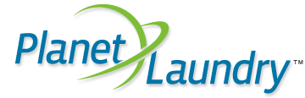
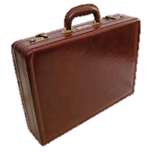
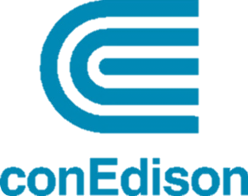




Online Ads
Trade Publications
Xlint.lyWebsite
Sales Force
Utility Partnerships
Reaching Our Customers
Notes:
How can we best tell our customers how amazing the award winning patent pending X-Lint is?
Online Ads: Planet Laundry website!! Google Adwords, Bing Ads, etc., keyword formation, SEO blah blah blah….
Trade publications: Planet Laundry publication (Larry)
Xlint.ly website!: simple e commerce
Sales Force: Simple, come to you, demonstration, easy installation, start saving quickly (Larry and Paul)
Utility partnerships: making it easier for the consumers, simple rebate process, less out of pocket expense for the consumer. (George & Martha)

Slide 17
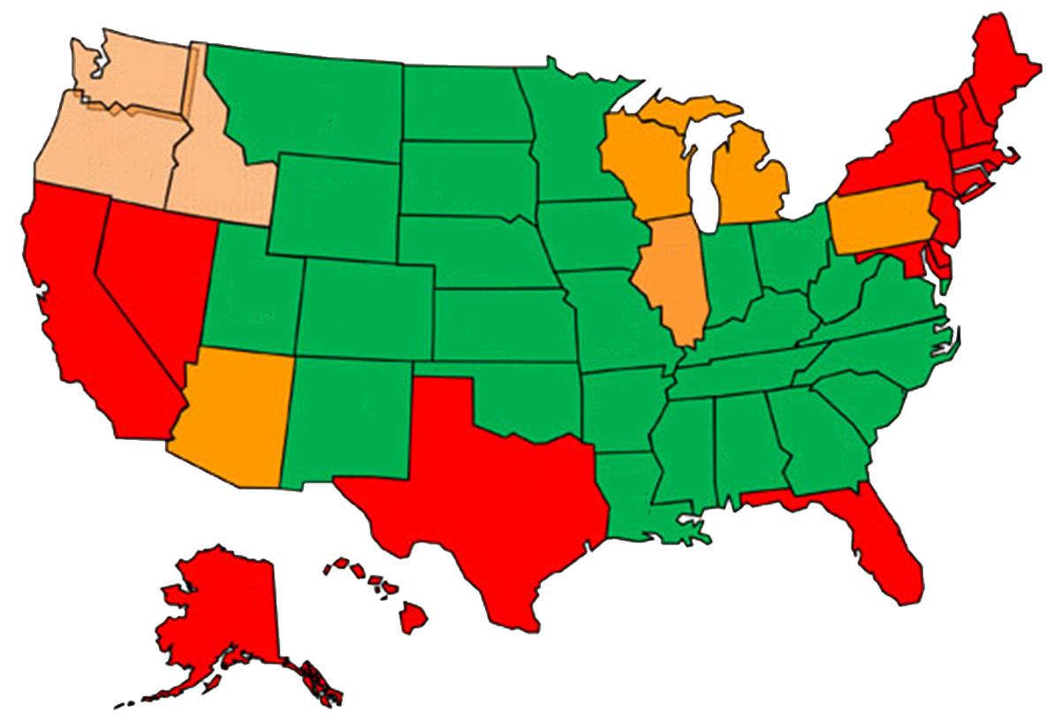
Go To Market Strategy
Notes:
We start out in Colorado. We have established relationships here which should help us get off the ground. This is our test market and proof of concept.
From here, we look to densely populated areas that have high electricity costs (indicated by the red on the map)
-- California, Texas and New York.
Combined, the dozen or so utilities in these areas touch 42 million potential customers
From these 42 million potential customers, Tee will explain how this impacts X-Lints financial prospects…
Now I am going to pass it off to Tee to talk about our financial situation

Slide 18
A Closer Look At 2 Target Markets
CA
$0.136 per kWh
Payback +21%
Major utilities:
  SCE (14M)
  PG&E (5.1M)
  SDG&E (3.3M)
NY
$0.157 per kWh
Payback +32%
Major utilities:
  NYSEG (2.9M)
  ConEd (3M)
  Nat’l Grid (3.3M)

Slide 19
Selected Financials

Slide 20
 | Year 1 | Year 2 | Year 3 | Year 4 | Year 5
Revenues | 191,700 | 603,225 | 790,560 | 1,186,290 | 2,256,750
Cost/Expenses
COGS | 77,758 | 165,012 | 223,564 | 297,555 | 507,495
Operating expense | 141,686 | 277,361 | 391,051 | 666,032 | 1,169,565
Total | 219,444 | 442,373 | 614,615 | 963,587 | 1,677,060
Net Income | (72,744) | 125,609 | 105,567 | 133,622 | 347,814
Notes:
Revenues, Cost, then Net Income on table
Hilight blue in revenues (Y1 Y2 Y5), Red costs, green net income (Y1, Y2, Y5)
Tee – utility (enunciate) 219,444 442,373 614,615 963,587 1,677,060

Slide 21
Sources of Revenue

Slide 22
Rebates, You Say…?
Analogs
  CFLs
  Energy Star Appliances
Tools

Slide 23
Save you time
Award winning, patent pending
X-Lint helps…
Save you money
Save the environment
Save your life*
Notes:
Tee- Thank you
Clogged dryer filters reduce airflow, increase drying times, and pose fire hazards. More than 15,000 dryer fires occur each year in the US due to clogged dryer systems - $45 for this easy, innovate solution is a great investment in your safety.
The X-Lint will save you time and money while helping save the environment and… it may just save your life.
Thank you again for you time & a special thanks to my team. Without further ado, we’re open to questions; if you’re looking for a place to start, we have some suggestions ☺

Slide 24
AWARDS??
Cost of customer Acquisition
Financial Ratios
Schematics
Management
Benchmarks
Risks
Competitive Advantage
Customer Survey
International Operations
Assumptions
Operations
Biz Dev
Questions?

Slide 25
Appendix
Notes:
This is all the extra stuff

Slide 26
Award Winning
CU NVC Pitch Night
  Biggest dreamer with a chance of succeeding
Net Impact Conference - Wal-Mart Quick Pitch Competition
  1st place
    Walmart.com’s Director of Sustainability : “If you had this today, we would help you commercialize it.”
    Walmart’s Director of Global Supply Chain: “It was a unanimous decision on the judges in the first 5 seconds of deliberation which pitch was #1.”

Slide 27
Competitive Advantage
Provisional Patent
  Registration Number
    61551703

Slide 28
Customer Survey

Slide 29
Risks
Utility partnerships don’t work out
Patent infringement
Testing reveals lower effectiveness than estimated
Cost to produce for a large number of dryer filter configurations (see next slide for A, B, C)

Slide 30
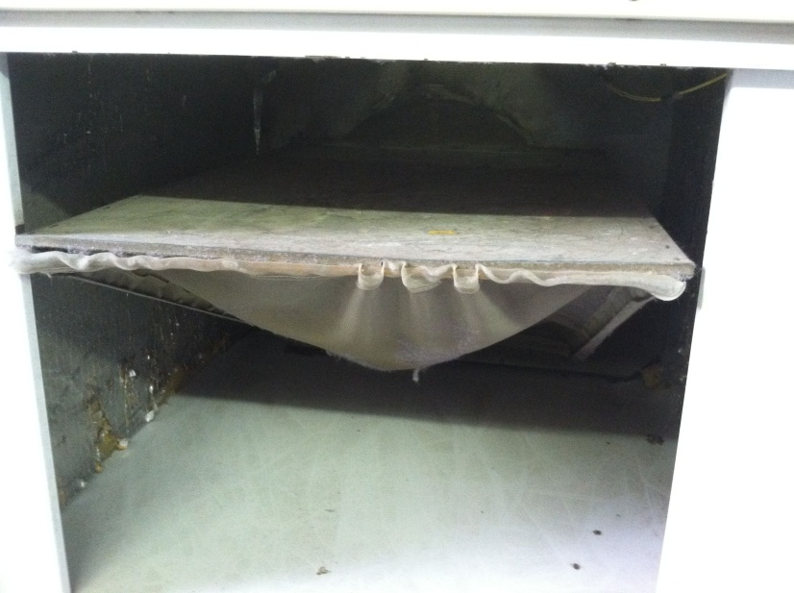
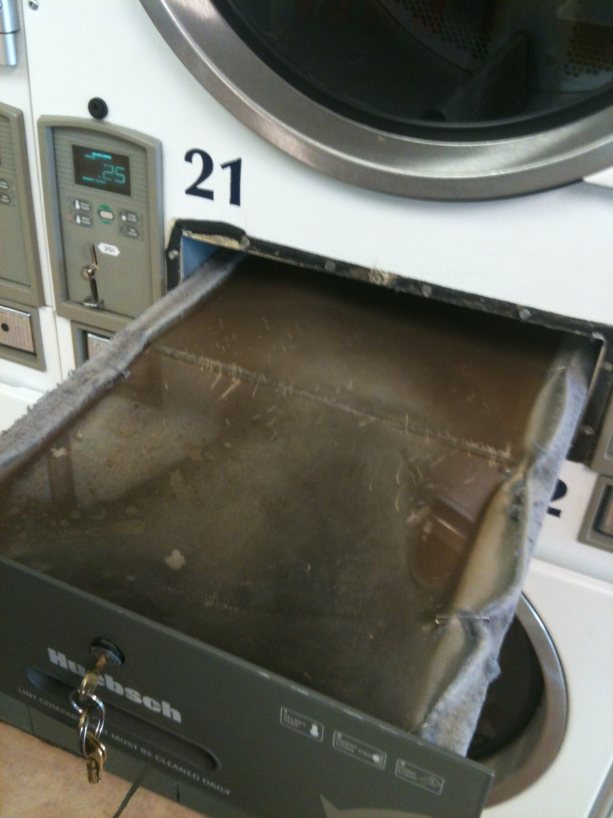
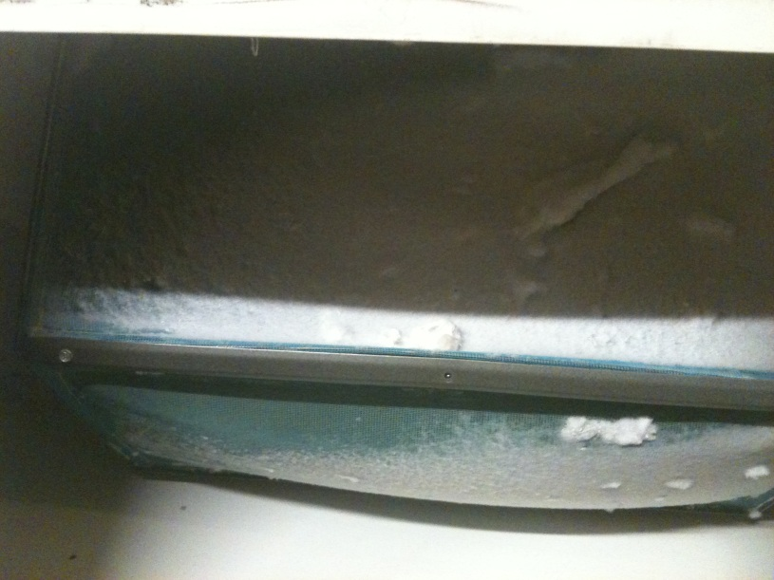
Commercial Filter Types

Slide 31
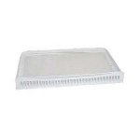
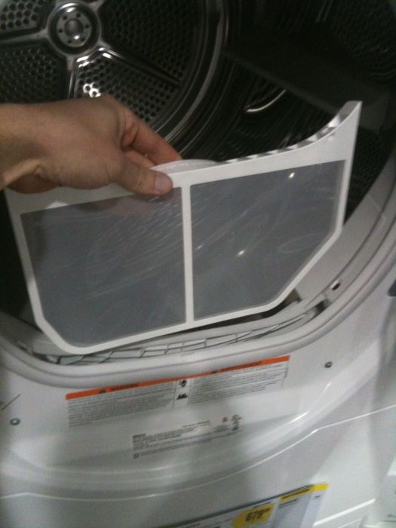
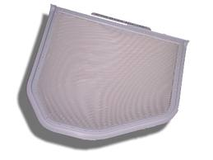
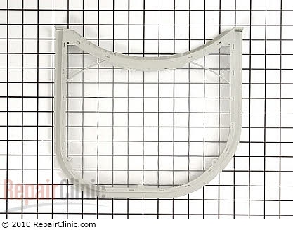
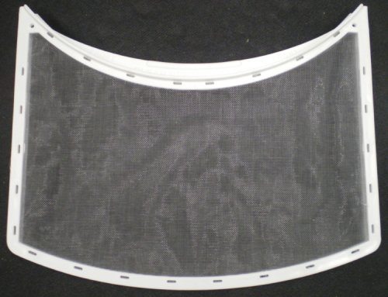
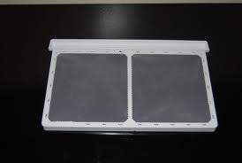
Household Filter Type A

Slide 32
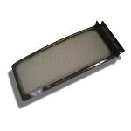
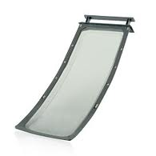
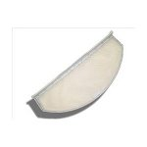
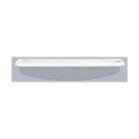
Household Filter Types B & C
Type B
Type C

Slide 33
International Operations
China: the good the bad and the ugly

Slide 34
Operations
High level description
Target market
Distribution – channel
Positioning
Sales strategies
Notes:
We’ve made the sale but now we have to get the product to them…
Produce in China.
Assemble in the US
Ship…
Provide a rebate redemption service
Go to market strategy

Slide 35
Assumptions
Margins
Comps
Break-even
Major expenditures
Working capital
Burn rate
Customer acquisition cost
Notes:
What are the Brooklyn Bridges and Lincoln tunnels we needed to have in place to get to the numbers that we have?

Slide 36
Business Development
Key things that need to happen to scale
  Dryer filter variations
  Assembly of the X-Lint
  Logistics (packing & shipping)
  Funding
Notes:
Where are we going to look for these people?
http://factfinder.census.gov/servlet/ThematicMapFramesetServlet?_bm=y&-_MapEvent=zoom&-errMsg=&-_useSS=N&-_dBy=330&-redoLog=false&-_zoomLevel=10&-tm_name=ACS_2009_5YR_G00_M00621&-tm_config=|b=50|l=en|t=5309|zf=0.0|ms=thm_def|dw=33.18084626058803|dh=17.656425207351308|dt=gov.census.aff.domain.map.EnglishMapExtent|if=gif|cx=-114.17580284137583|cy=44.779236580446664|zl=9|pz=9|bo=|bl=|ft=|fl=|g=01000US|ds=ACS_2009_5YR_G00_|sb=49|tud=false|db=330|mn=55.9|mx=77.2|cc=2|cm=1|cn=3|cb=|um=Percent|pr=1|th=ACS_2009_5YR_G00_M00621|sf=N|sg=&-PANEL_ID=tm_result&-_pageY=&-_lang=en&-_pageX=&-geo_id=01000US&-CONTEXT=tm&-_mapY=&-_mapX=&-_latitude=&-format=&-_pan=&-ds_name=ACS_2009_5YR_G00_&-_longitude=&-_changeMap=pan
http://chronicle.com/article/Map-Number-of-Colleges-and/48155/
http://www.electricchoice.com/electricity-prices-by-state.php

Slide 37
Operations
How they add value
Describe process
  Manufacture
  Assembly
  Order fulfillment
Major expenditures
  Mold: $5,000

Slide 38
Benchmarks
Timeline
3-5 events critical to success of venture

Slide 39
Financial Ratios
Notes:
This is the actual money we have on hand that we can use to buy stuff like cool chairs and light sabers!

Slide 40
Income Statement

Slide 41
Balance sheet

Slide 42
Cash Flow

Slide 43
Funding and Valuation

Slide 44
Financial Statement (P = $40)

Slide 45
Financial Statement (P = $40)

Slide 46
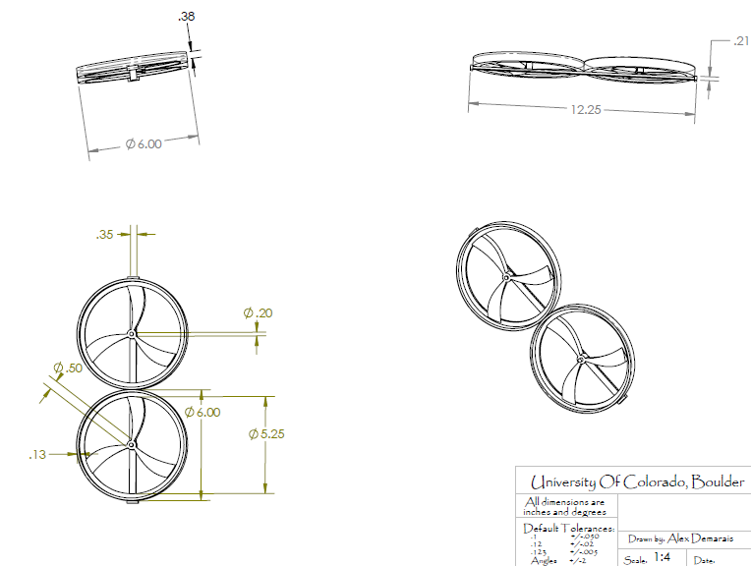
New design image

Slide 47
Management
Year 1 | Year 2 | Year 3 | Year 4 | Year 5
Justin Lowell-Bellew (CEO) Operations Manager Sales Manager |  |  | Marketing Manager

